Slide 1
Loan prediction
Group 1
Mentor Name : Karthik , Dileep

Slide 2
Contents
INTRODUCTION
PROJECT FLOW
DATA PREPARATION
MODEL BUILDING
MODEL DEPLOYMENT

Slide 3
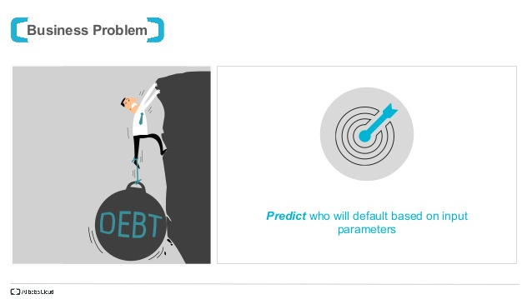
BUSINESS PROBLEM:

Slide 4
Objective: To classify if the borrower will default the loan using borrower’s finance history. That means, given a set of new predictor variables, we need to predict the target variable as 1 -> Defaulter 0 -> Non-Defaulter.
A MIS_Status of a Bank will be Default when a borrower would not be able to make payment on time or delays payments , refuses or avoids payment. An Individual , Organizations and even states could fall under default. To avoid the loss we have come up with a model which could predict whether one could fall under Default or will he be able to pay in full.

Slide 5
Project Flow

Slide 7
Data Preparation – Out of the 26 features in our dataset, Many of them had empty cells. We have Imputed such cells. Also, the features which didn’t seem relevant to our goal were removed.
Data Modelling – Data will be divided into two parts. Training data and testing data. The plan is to develop a model. The model will be developed on Training data and Evaluated on Test data.
Model Evaluation – After developing the Model it is evaluated on accuracy, precision, recall and F1 score .
Model Deployment – The Model is deployed using flask

Slide 8
DATA Preparation

Slide 9
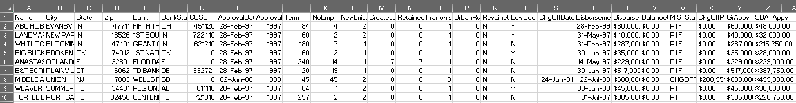
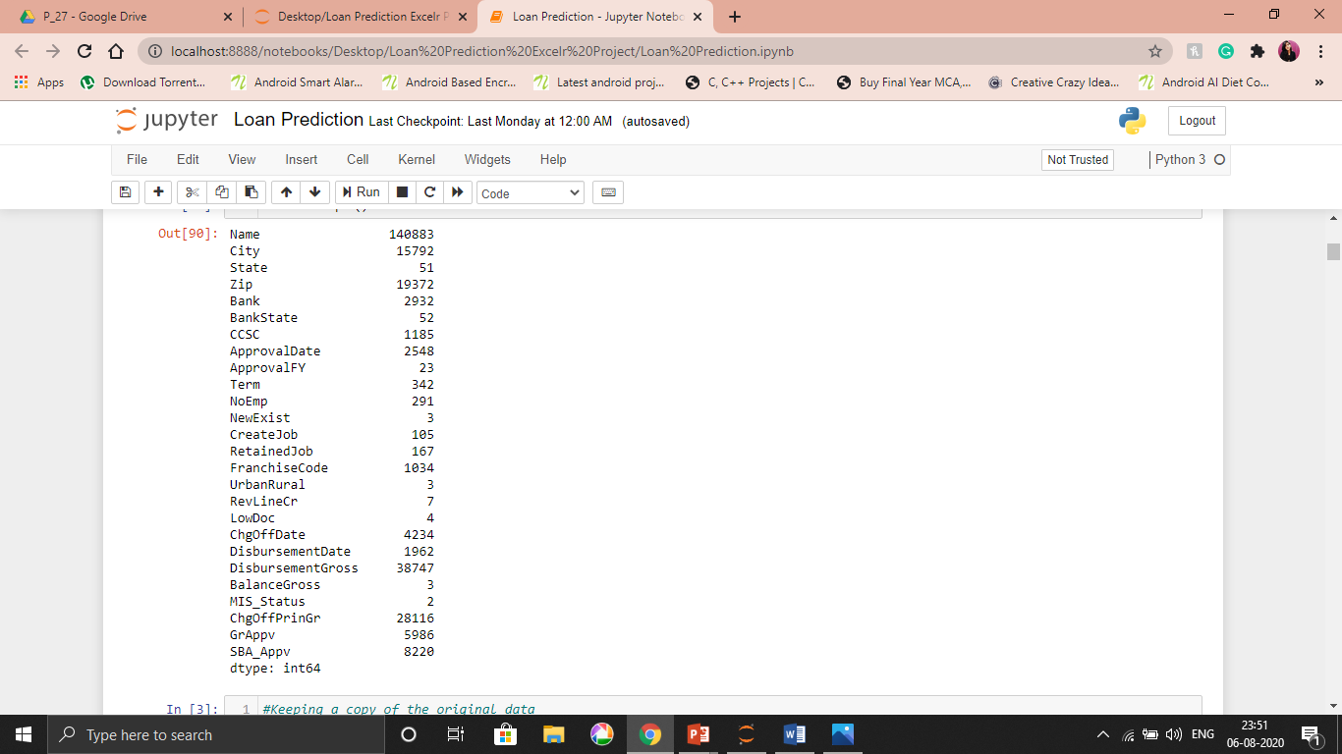
EDA(Exploratory Data Analysis)
Total number of rows – 149999
Total number of columns – 26
Date ranges (Year’s) – 1962 to 2007
Missing Values - 110938
Target Variable - MIS_Status
Unique Values of each variable

Slide 10
Loan Data: Data types
Target Variable:
1. Charge OFF
2. Paid in Full
Numerical:
1. Zip
2. CCSC
3.ApprovalFy
4. Term
5. NoEmp
6. Create Job
7. Retained Job
8. Disbursement Gross
9.Balance Gross
10.Chg Off Prin Gr
11. GrAppv
12. SBA_Appv
Unique:
1.Name
2.City
3.State
4.Bank
5.BankState
6. ApprovalDate
7.ChgoffDate
8. DisbursementdaDate
Categorical:
1. New Exist
2. LowDoc
3. Franchise Code
4. Urban Rural
5. RevLineCr
6. MIS_Status

Slide 11
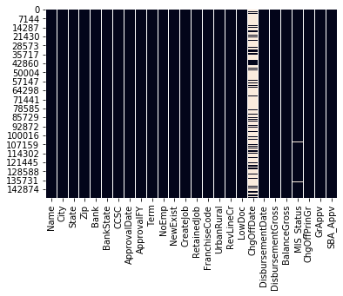
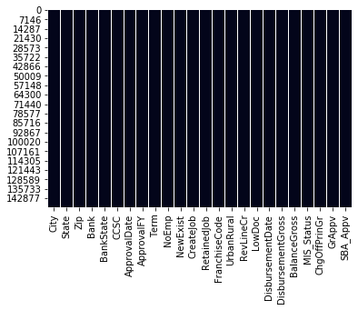
DATA Engineering
Before Dealing with the Missing values
The dataset had many empty and irrelevant features They have been removed.
● String values have been formatted to integers.
● Categorical values have been transformed to numerical.
● Redundant variables have been dropped.
● Filled NAN values with mode values of corresponding columns.
After Dealing with the
Missing values

Slide 12
Variable Transformation
“DisbursementGross”, “BalanceGross”, “ChgOffPrinGr”, “GrAppv”, “SBA_Appv” these variables are converted to numeric.
MIS_Status : PIF : 0(110831) ChgOff : 1(38926)
Franchise Code: - No Franchise : 0(144504) , Franchise :1(5253)
NewExist : 1 = Existing Business(101773), 2 = New Business(47984)
Low Doc : No(0) : 137716 Yes(1) :12041
RevLineCr : No (0):- 95157 Yes(1) :-54600

Slide 13
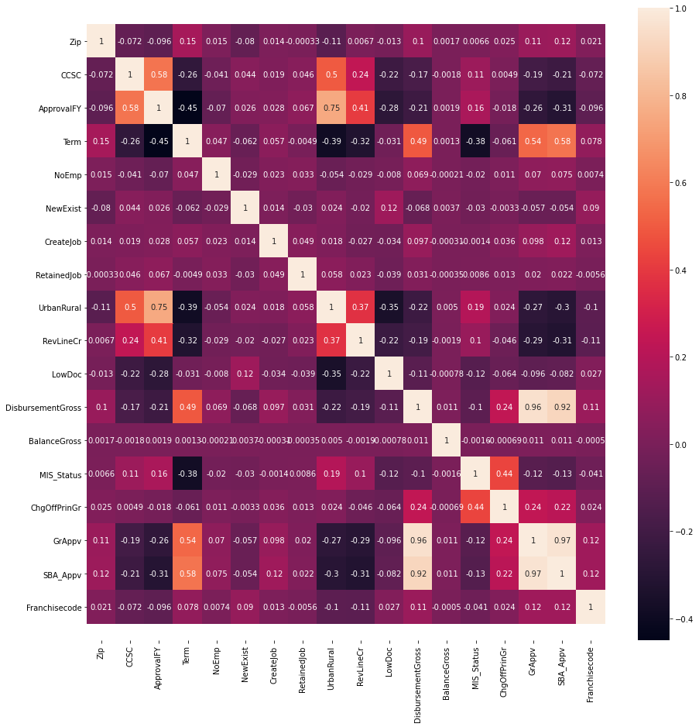
Correlation Matrix

Slide 14
Univariate Graph Description
City – LOS ANGELES, NEW YORK & MIAMI Are Top Three city.
State – CA, NY & TX Are Top Three State.
Bank - Bank OF AMERICA NATL ASSOC, CITIZENS BANK NATL ASSOC & CAPITAL ONE NATL ASSOC Are Top Three Bank.
Bank State – NC, RI & IL Are Top Three Bank State.
CCSC – There are total 1184 Unique codes.
APPROVAL DATE - Most of the Small Business Administration Commitment were Approved on 1997-09-30.
Term – Most of the Loans have a term of 84.
NoEmp – Number of Business Employees(SUM) - 30787
NewExist – Existing Business -101648 New Business-47984
Create job & Retained job – Number of Jobs created 37130
LowDoc – LowDoc Loan program: Y=12041 , N=137632

Slide 15
12. Urban Rural – Urban-81724 rural-51370
13. RevLineCr - Revolving Line of Credit Yes=71503, NO=49780
14. MIS_Status(target Variable) - Loan Status CHGOFF(high risk)-38926, PIF( lower risk)- 110831
15. Disbursement Date –Most of loan amount was Disbursed on 2006-05-31
16. GrAppv – Minimum-200 and Maximum-4000000
17. SBA_Appv – Minimum-100 and Maximum-4000000

Slide 16
Bivariate Graph Description
Bank With Highest Gross Approval – The Top 3 bank with highest Gross Approval amount are SMALL BUS. GROWTH CORP, FIRSTMERIT BANK, N.A and GE CAP. SMALL BUS FINAN CORP.
Bank State With Highest Gross Approval – The top 3 Bank States with highest Gross Approval are ILLINOIS , OHIO and TEXAS
Urban/Rural with Gross Approval – People Staying in Urban areas are having more Gross Approval than the other
Urban/Rural with Gross Approval and MIS_Status – People staying in Rural with Gross Approval of less than 100000 are mostly falling under PIF as Compared to the Urban.
NewExist With Term period and MIS_Status - From the above graph we can see the people with Existing Bussiness with Term period of 120 fall under PIF
GrAppv , LowDoc with MIS_Status - People with No LowDoc Loan Program are mostly under PIF
RevLineCr with MIS_Status - People with No Revolving Line of Credit fall more under PIF than the people with those.
NewExist and MIS_Status – People with the Existing Business are more falling under PIF

Slide 17
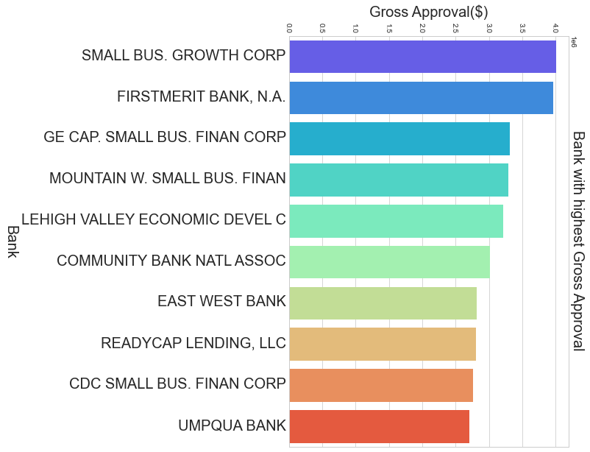
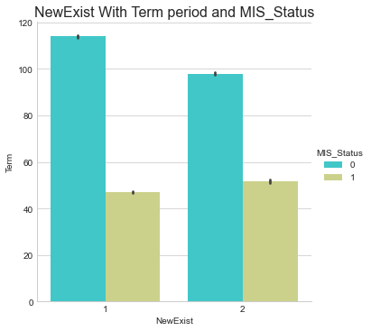
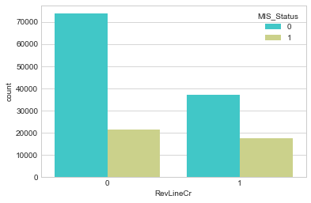
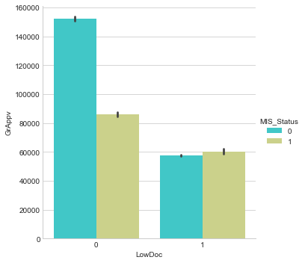
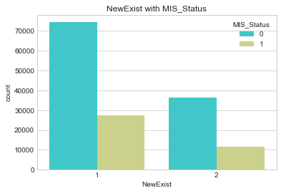
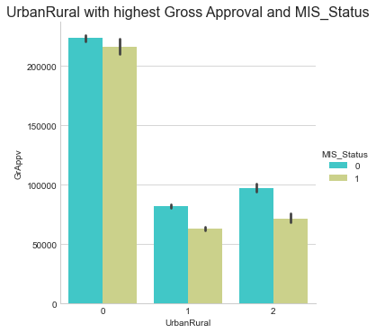
Graphs:

Slide 18
Model Building

Slide 19
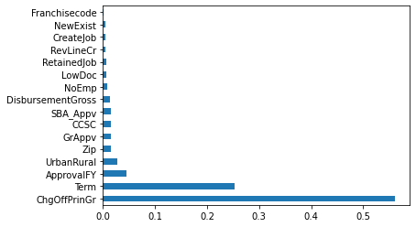
Feature Importance
Using ExtraTreesClassifier, feature importance is determined and unnecessary variables are removed again. Below columns shows high Importance:
“Zip”, “CCSC” , “ApprovalFY” , “Term”, “UrbanRural” , “LowDoc”, “DisbursementGross”, “GrAppv”, “SBA_Appv”
We are dropping ChgoffPrinGr because it depends on the target variable.

Slide 20
MoDels Built
SGDClassifier.
Support Vector Machine (SVM)
KNN (K- Nearest Neighbour)
Random Forest
Random Forest with RandomizedSearchCV
Random Forest with SMOTE
XGBClassifier

Slide 21
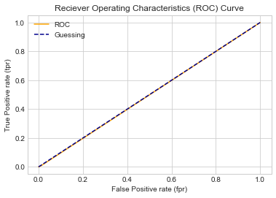
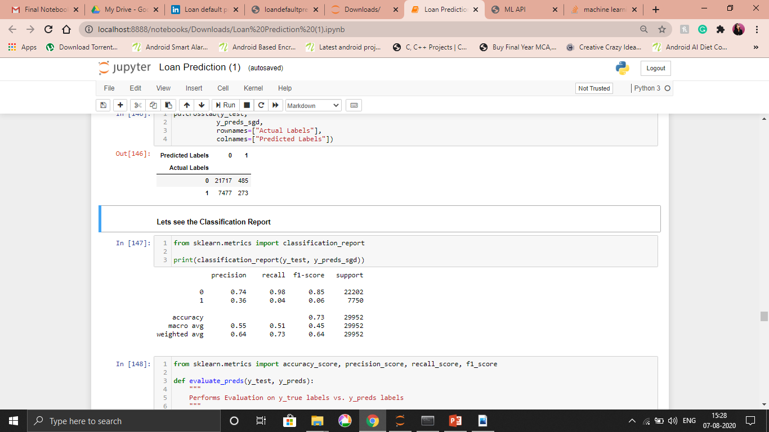
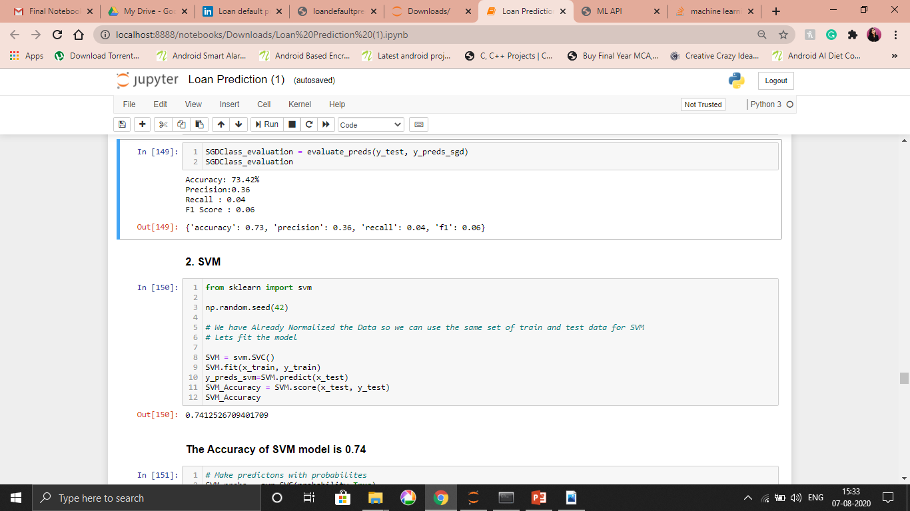
SGDClassifier (Stochastic gradient descent)
SGD is a technique that is used to find the minima of a function. SGDClassifier is a linear classifier (in sklearn it is a linear SVM) that uses SGD for training (that is, looking for the minima of the loss using SGD).
The Area under the Curve Using SGDClassifier is 0.49

Slide 22
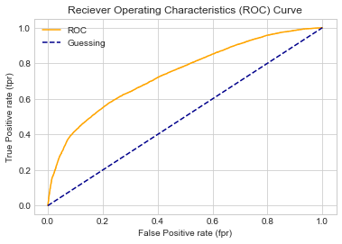
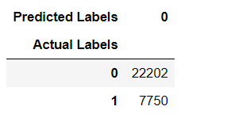
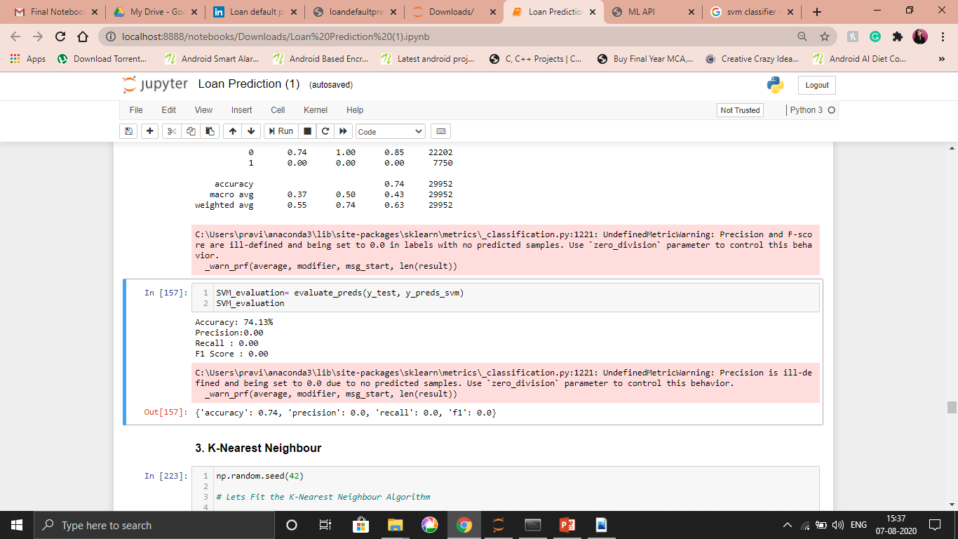
SVM
The Area under the Curve using SVM is
0.70

Slide 23
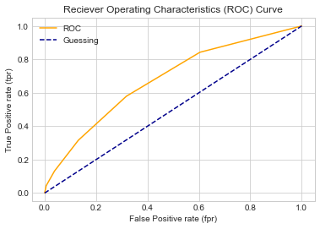
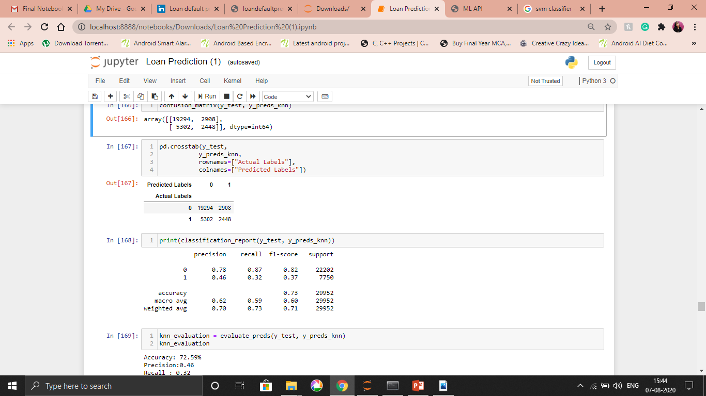
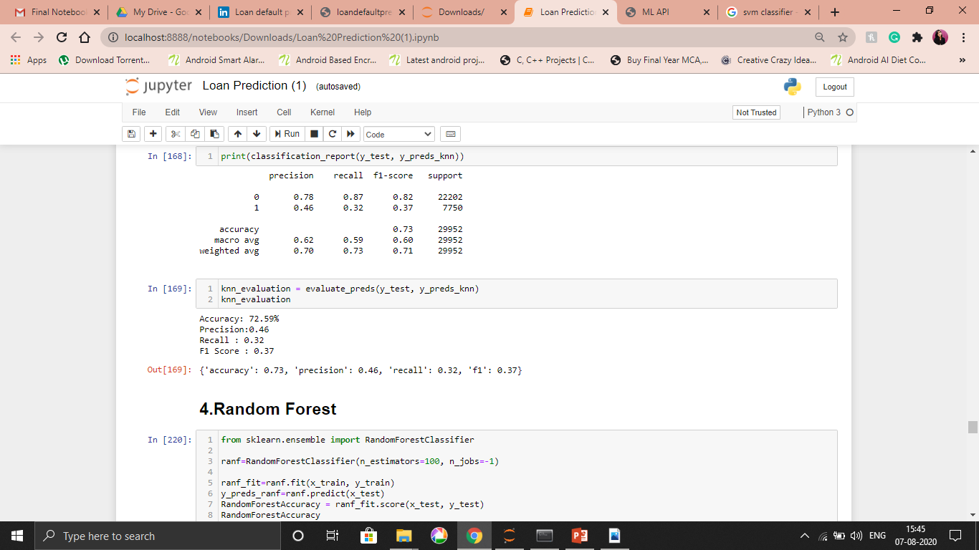
KNN
The Area under the Curve for this model is
0.675

Slide 24
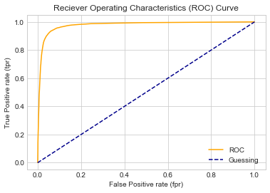
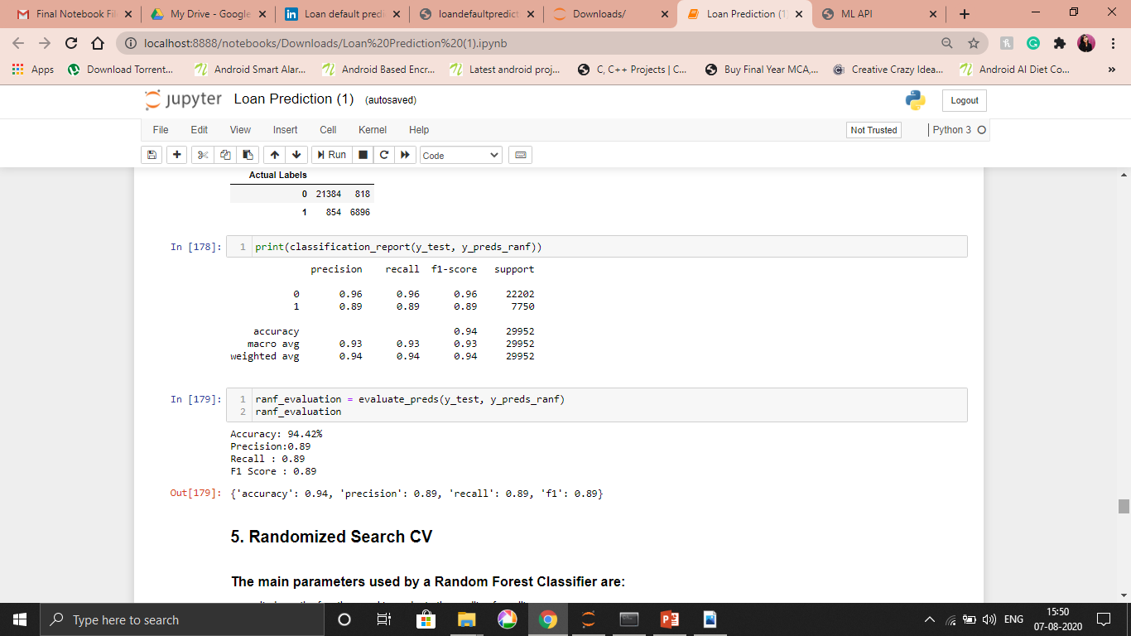
Random Forest(Deployed Model)
The Area under the Curve for this model is
0.977

Slide 25
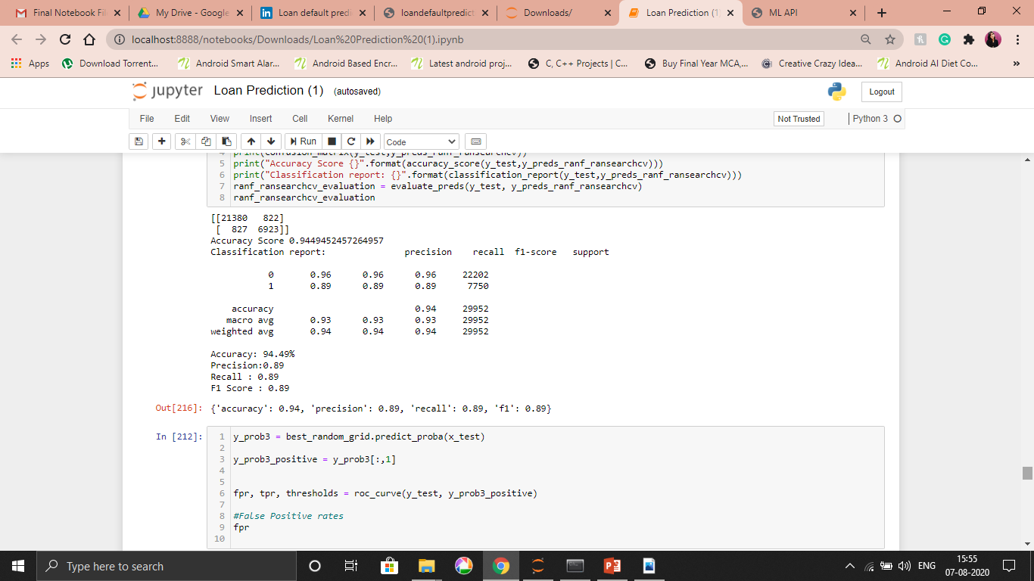

RandomForest with RandomizedSearchCV
The Area under the Curve for this model is
0.978

Slide 26
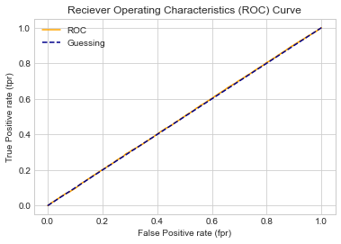
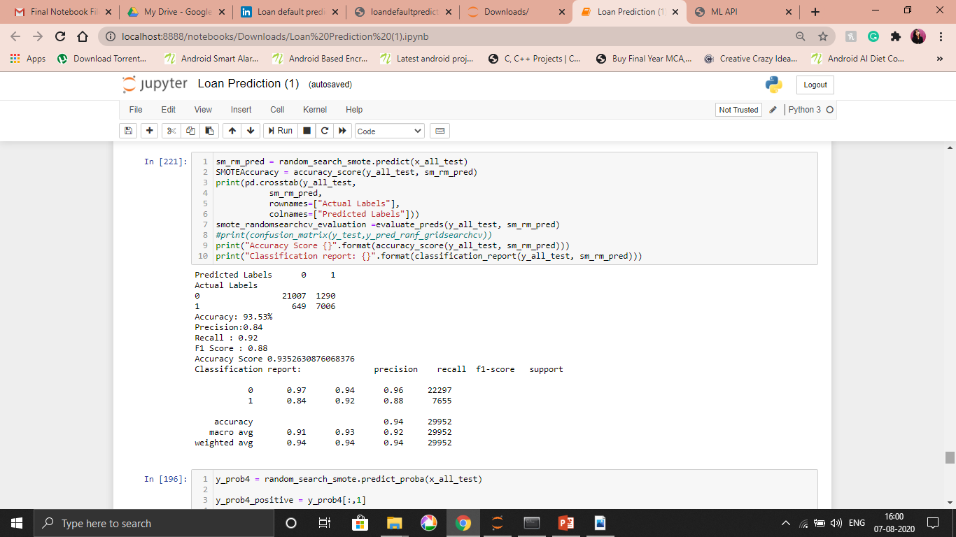
SMOTE with Random Forest
The Area under the Curve for this model is
0.50

Slide 27
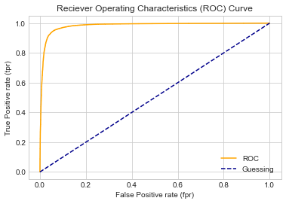
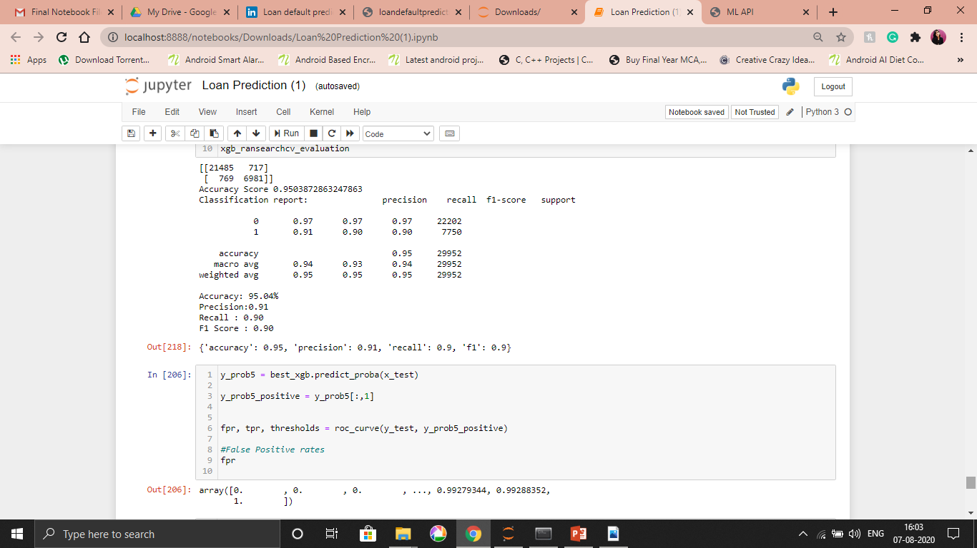
XBGClassifier(Best Model)
The Area under the Curve for this model is
0.98

Slide 28
Model Evaluation
For our Loan default prediction project, False Negatives Rate is the best metric to evaluate the model. Lower the number of false negatives, better the model is.
In this project, False negative is when model predicting “a borrower will not default a loan even though he will “. Our model cannot afford having higher False Negatives as it leads to negative impact on the investors and the credibility of the company. So, we evaluated our models using the number of False negatives and accuracies.

Slide 29
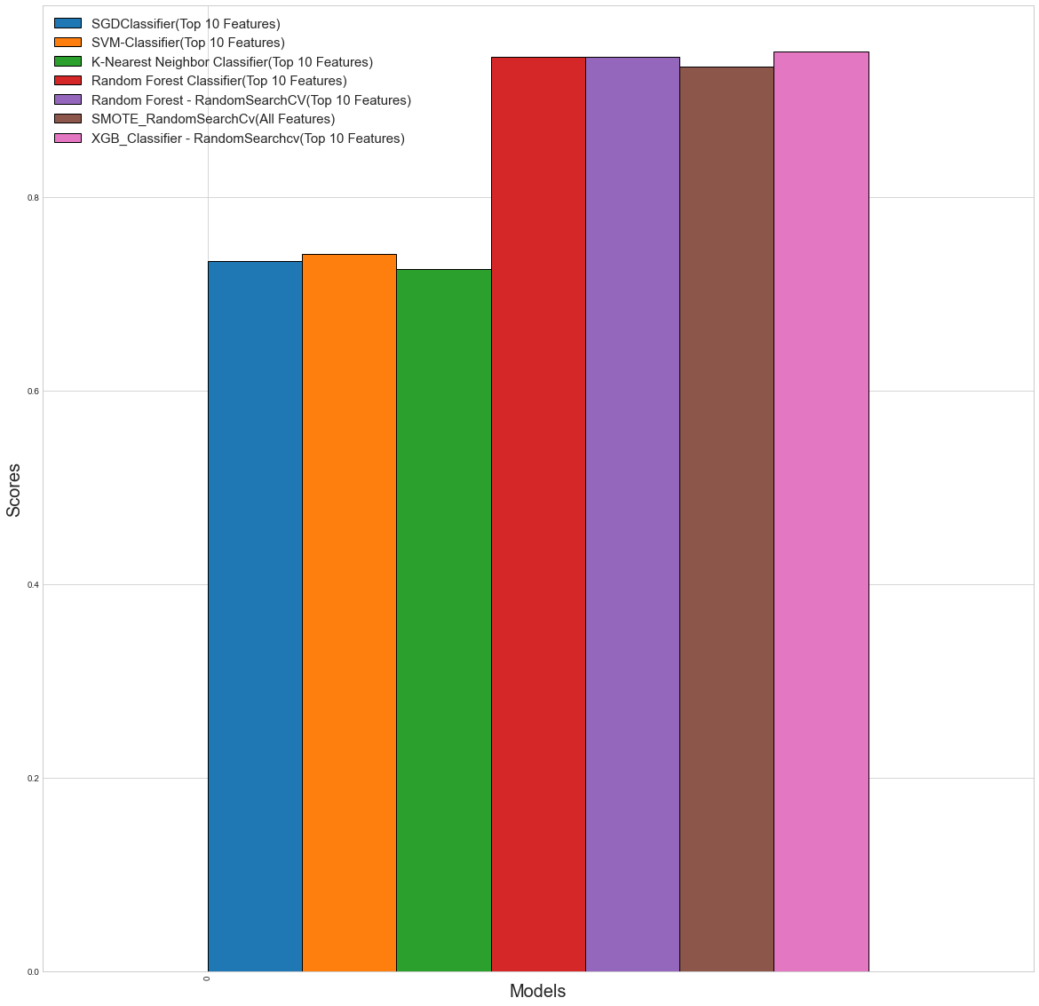
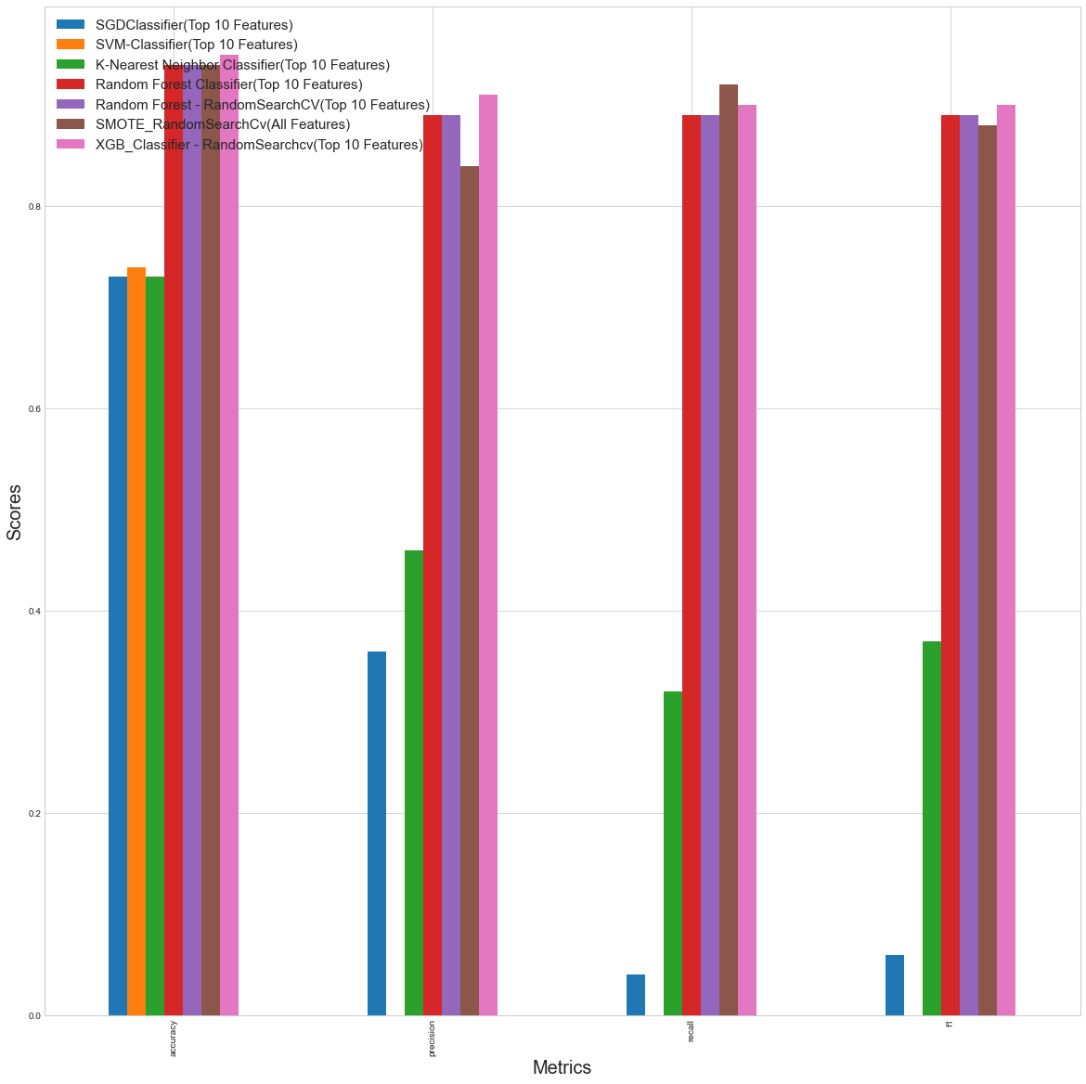

Slide 30
Model Deployment

Slide 31
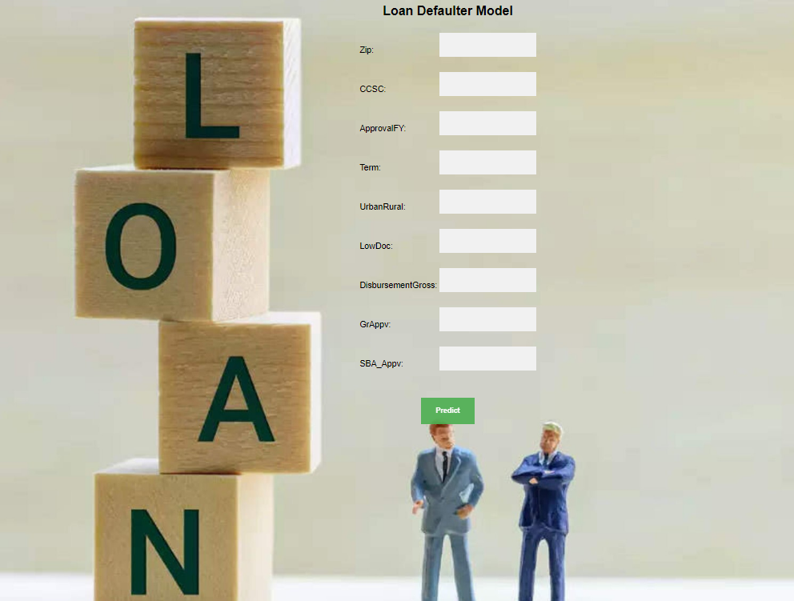
We did Model deployment using Flask. Flask is a micro web framework written in Python. It can create a REST API that allows you to send data, and receive a prediction as a response.

Slide 32
Thank You!
Nikita Salunkhe
Rashmi Bhujbal
Pravin Konar
Uttej Reddy
Mandar Makhi
Shubham More

